Slide 1

Dinning Philosophers problem
Presenter:
SUNNY SOOD(2021A1R017)
SHIVAM KUDA(2021A1R019)

Slide 2
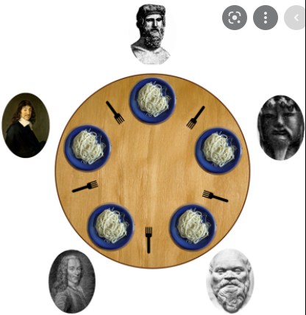
Dinning Philosophers problem

Slide 3
Dinning Philosophers problem
The dining philosophers problem states that there are 5 philosophers sharing a circular table and they eat and think alternatively.
There is a bowl of rice for each of the philosophers and 5 chopsticks.
A philosopher needs both their right and left chopstick to eat.
A hungry philosopher may only eat if there are both chopsticks available. Otherwise a philosopher puts down their chopstick and begin thinking again

Slide 4
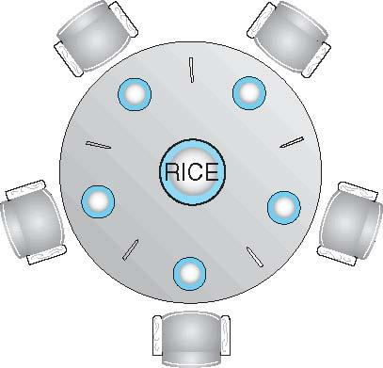
Dining-Philosophers Problem
Philosophers spend their lives alternating thinking and eating
Don’t interact with their neighbors, occasionally try to pick up 2 chopsticks (one at a time) to eat from bowl
Need both to eat, then release both when done
In the case of 5 philosophers
Shared data
Bowl of rice (data set)
Semaphore chopstick [5] initialized to 1

Slide 5
Dining-Philosophers Problem Algorithm
The structure of Philosopher i:
do {
wait (chopstick[i] );
wait (chopStick[ (i + 1) % 5] );
// eat
signal (chopstick[i] );
signal (chopstick[ (i + 1) % 5] );
// think
} while (TRUE);
What is the problem with this algorithm?

Slide 6
Dining-Philosophers Problem Algorithm (Cont.)
Deadlock handling
Allow at most 4 philosophers to be sitting simultaneously at the table.
Allow a philosopher to pick up the forks only if both are available (picking must be done in a critical section).
Use an asymmetric solution -- an odd-numbered philosopher picks up first the left chopstick and then the right chopstick. Even-numbered philosopher picks up first the right chopstick and then the left chopstick.

Slide 7
Dining Philosophers Problem
Void Philosopher
{
while(1)
{
take_chopstick[i];
take_chopstick[ (i+1) % 5] ;
. .
. EATING THE NOODLE
.
put_chopstick[i] );
put_chopstick[ (i+1) % 5] ;
.
. THINKING
}
}

Slide 8
Modified code by using semaphores
void Philosopher
{
while(1)
{
Wait( take_chopstickC[i] );
Wait( take_chopstickC[(i+1) % 5] ) ;
. .
. EATING THE NOODLE
.
Signal( put_chopstickC[i] );
Signal( put_chopstickC[ (i+1) % 5] ) ;
.
. THINKING
}
}

Slide 9
THANK YOU

